Slide 1
Amazon EC2
Presented by:
Ayat Hany Ahmed 20186007
Nada Mohamed Fathy 20186031

Slide 2
Content:
Introduction.
What is Amazon EC2?
Features of Amazon EC2.
Functionality of Amazon EC2.
Access Amazon EC2.

Slide 3

Introduction:
AWS (Amazon Web Services) is a comprehensive, evolving cloud computing platform provided by Amazon that includes a mixture of infrastructure as a service (IaaS), platform as a service (PaaS) and packaged software as a service (SaaS) offerings.
AWS services can offer an organization tools such as compute power, database storage and content delivery services.

Slide 4
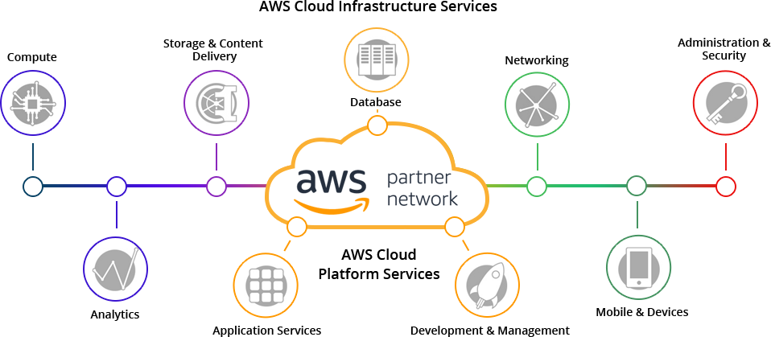
AWS has plenty of services to offer in a number of domains.

Slide 5
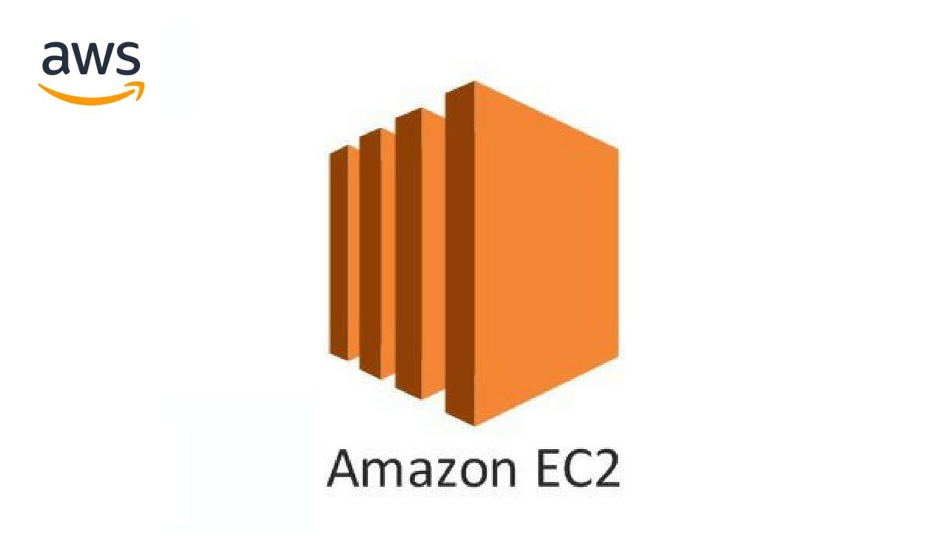
But let’s talk about a service in compute that is provided by Amazon EC2.

Slide 6
What is Amazon EC2?
It refers to Amazon Elastic Compute Cloud which is Infrastructure as a service(IaaS)
It provides scalable computing capacity in the Amazon Web Services (AWS) Cloud.
Using Amazon EC2 eliminates your need to invest in hardware up front, so you can develop and deploy applications faster.

Slide 7
What is Amazon EC2?
You can use Amazon EC2 to launch as many or as few virtual servers as you need, configure security and networking, and manage storage.
Amazon EC2 enables you to scale up or down to handle changes in requirements or spikes in popularity, reducing your need to forecast traffic.

Slide 8
Features of Amazon EC2

Slide 9
Amazon EC2 provides the following features:
Virtual computing environments, known as instances.
Preconfigured templates for your instances, known as Amazon Machine Images (AMIs), that package the bits you need for your server (including the operating system and additional software).
Various configurations of CPU, memory, storage, and networking capacity for your instances, known as instance types.

Slide 10
Ease in scaling up and down.
Can be integrated into several other services.
Pay only for what you use.
Secure login information for your instances using key pairs.
(AWS stores the public key, and you store the private key in a secure place)

Slide 11
Storage volumes for temporary data that's deleted when you stop, hibernate, or terminate your instance, known as instance store volumes.
Persistent storage volumes for your data using Amazon Elastic Block Store (Amazon EBS), known as Amazon EBS volumes.
Multiple physical locations for your resources, such as instances and Amazon EBS volumes, known as Regions and Availability Zones.

Slide 12
Functionality of Amazon EC2:
Amazon EC2 presents a true virtual computing environment, allowing you to use web service interfaces to launch instances with a variety of operating systems, load them with your custom application environment, manage your network’s access permissions, and run your image using as many or few systems as you desire.

Slide 13

To use Amazon EC2:

Slide 14
1)Choosing an AMI:
An AMI refers to Amazon machine image.
It is a template that is used to create a new instance based on user requirements.
AMI contains :
Software information
Operation system information
Volume information
Access permissions

Slide 15
1)Choosing an AMI:
AMI’s are of two types :
Predefined AMIS
Custom AMIS
AMI Marketplace.

Slide 16
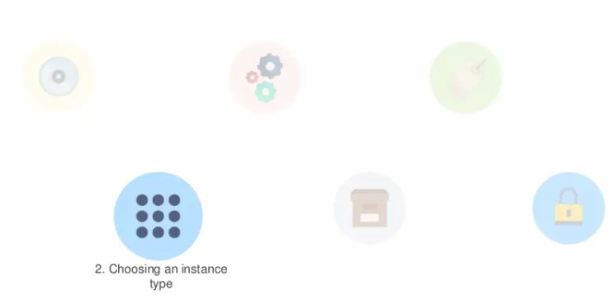

Slide 17
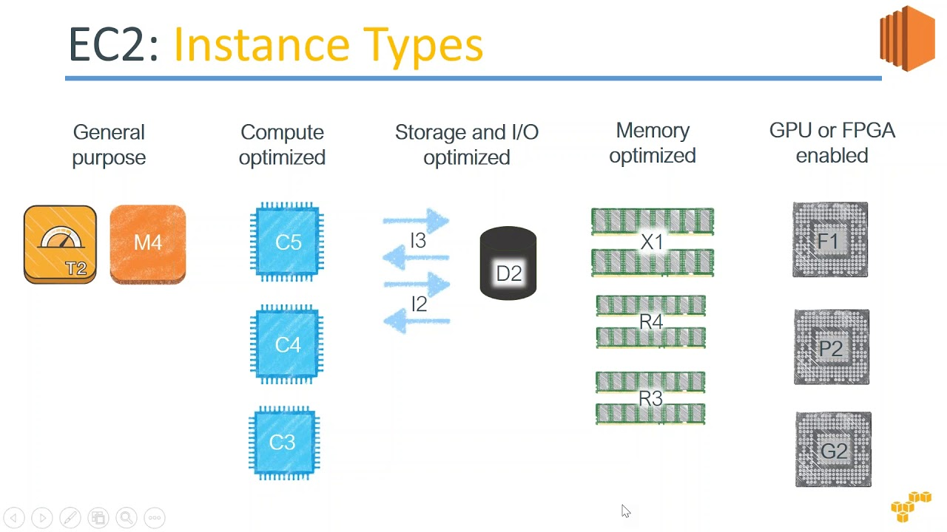
2)Choose instance type:
An instance type specifies the hardware specifications that are required in the machine.
These instances is divided into 5 main group :

Slide 18


Slide 19
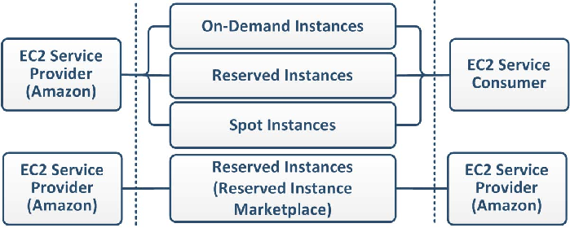
3)Configure instance:
You have to specify the number of instance, purchasing options, the kind of network, the sub net, when to assign a public IP, the IAM role, the shutdown behavior and so on.
Under the advanced details, users can add bootstrap scripts that are executed when the virtual machine stars up.
There are also multiple payment options available:

Slide 20


Slide 21
4)Adding storage:
Then we are deciding the types of storage, which could be:
Ephemeral Storage(Temporary and free)
Amazon Elastic Block Store(Permanent and paid)
Amazon S3
The size(in GBs), volume type, the location where the disk is mounted, and whether the volume needs to be encrypted have to be specified.
Free users get to access up to 30 GBs or SSD or Magnetic storage.

Slide 22


Slide 23
5)Adding tags:
Helps identify instances with ease.
Examples:
To know which team it belongs to.
To know which billing department it belongs to.

Slide 24


Slide 25
6)Configure security Group:
Used to specify rules of basis of which users are given access to EC2 instance.
You set up type of security protocol, port range, source (from where the incoming traffic is coming from).
Has to be explicitly specified and outgoing traffic is open.

Slide 26
Access Amazon EC2
Amazon EC2 provides a web-based user interface, the Amazon EC2 console.
If you've signed up for an AWS account, you can access the Amazon EC2 console by signing into the AWS Management Console and selecting EC2 from the console home page.
If you prefer to use a command line interface, you have the following options:
AWS Command Line Interface (CLI)
AWS Tools for Windows PowerShell

Slide 27
Summary
Introduction about Amazon Web Services(AWS).
Amazon EC2.
Amazon EC2 features.
Main functionality of Amazon Ec2(setup).
Accessing Amazon EC2.

Slide 28
Any Questions ?

Slide 29
Thank you ☺

